Slide 1
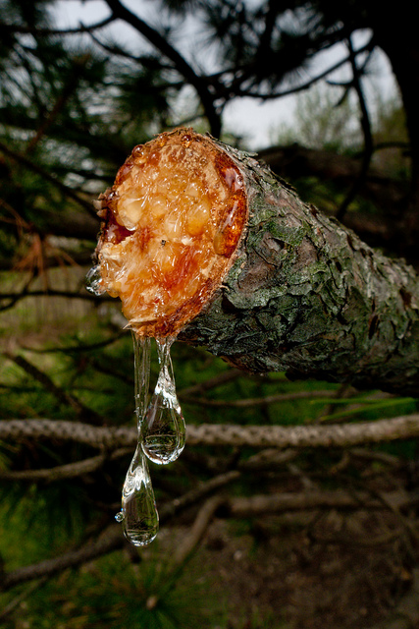
Technical Insights
IFF’s Unique
Pinene Chemistry

Slide 2
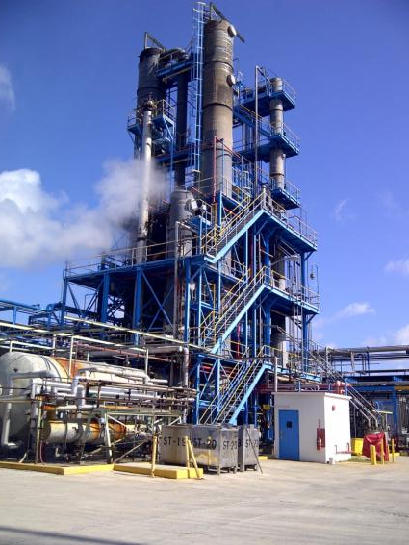
Pinene Chemistry
The largest Pine Oil plant in the world, IFF is the only fragrance house to have this capability.
We turn Crude Sulfate Turpentine, CST (a very smelly and toxic waste product from paper mills), into many very useful chemicals. Sustainability before it became trendy

Slide 3
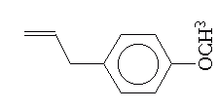
Crude Sulfate Turpentine
Crude Sulfate Turpentine
Alpha Pinene
Beta Pinene
Limonene &
Methyl Chavicol
Anethole &
Phellandrene
Caryophyllene
122ton 4USD
Unitene LP
Anethole U
Anethole C
23ton 14USD
Notes:
The Crude Sulfate Turpentine source is primarily from the Southeastern United States. The general composition is 60-64% Alpha Pinene, 20-22% Beta Pinene, 10-15% Limonene, Phellandrene & Alcohols, and 2% Methyl Chavicol and Anethole.
Turpentine from other global sources contains varying amounts of Alpha Pinene, many sources have no Beta Pinene while other sources have 40-50% Beta. No other region than Southeastern USA has the Methyl Chavicol/Anethole in appreciable quantity.
The Jacksonville plant operates a multi-step distillation process to separate the major constituents of Turpentine into high purity streams for further processing.

Slide 4
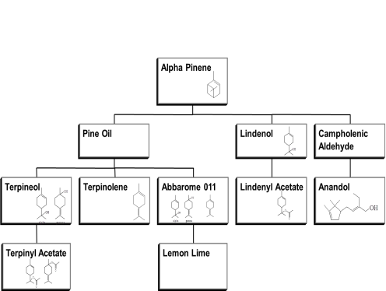
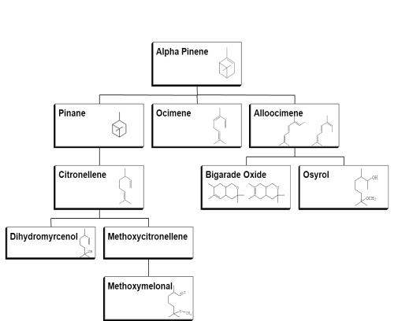
Alpha Pinene

Slide 5
Alpha Pinene
??? Kton 1USD
??? Kton 1USD
24ton 3USD
5Kton 10 USD
4ton 10USD
1ton 50USD
305ton 3USD
103Kton 2USD
5ton 15USD
1ton 65USD
5ton 59USD
2.200 ton 4USD
322ton 4USD
10ton 18USD
1 ton 136 USD

Slide 6
Alpha Pinene
Terpinyl acetate
Dihydromyrcenol

Slide 7
Beta Pinene
Beta Pinene
Myrcene
Boisvelone
Geraniol / Nerol
Azuril
Geranyl Acetate
Tetrahydrogeraniol
DMO
Citronellol
Citral
Linalool
Citronellyl Acetate
Hydroxycitronellal
Methyl Ionones & Ionones
Linalyl Acetate
Methoxycitronellal
Tetrahydrolinalool
Notes:
The Beta Pinene stream is the building block for Aroma Chemical production at the Jacksonville facility. The Beta Pinene is pyrolyzed to Myrcene which is used to make Boisvelone and Azuril at the Widne-UK facility or is used to make Geraniol/Nerol in Jacksonville.
The Geraniol/Nerol are the starting material for the range of Rose Alcohols and Esters produced by BBA. These include Citronellol, Tetrahydrogeraniol (DMO), Linalool, Geranyl/Neryl/Citronellyl Acetates.
The Jacksonville plant also produces a family of Ionones and Methyl Ionones from Citral.

Slide 8
Beta Pinene
Beta Pinene
Myrcene
1,5ton 19USD
Boisvelone
Geraniol / Nerol
Azuril
14ton 30USD
163ton 15USD
Geranyl Acetate
Tetrahydrogeraniol
???
70ton 9USD
DMO
Citronellol
Citral
Linalool
420ton 5USD
115ton 4,5USD
1450ton 4,7USD
Citronellyl Acetate
Hydroxycitronellal
Methyl Ionones & Ionones
Linalyl Acetate
53ton 10USD
68ton 12USD
419ton 4,7USD
Methoxycitronellal
Tetrahydrolinalool
???
437ton 5USD

Slide 9
Beta Pinene
Geraniol
Linalool

Slide 10
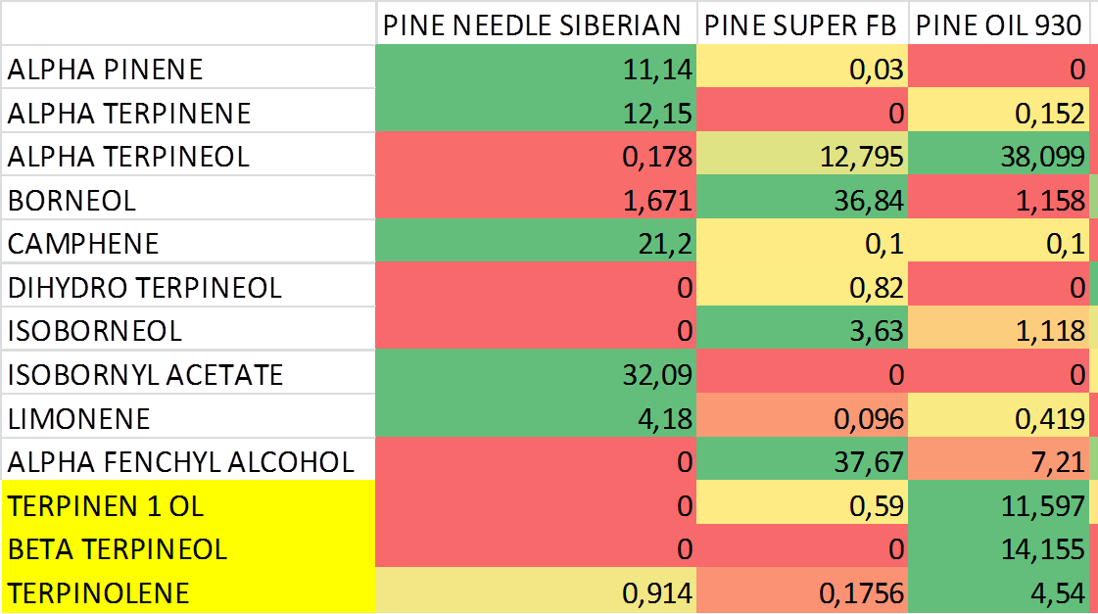
Components in commercial ingredients grades

